Slide 1
Chapter 5
Some Discrete Probability Distributions

Slide 2
Section 5.1
Introduction and Motivation

Slide 3
Section 5.2
Binomial and Multinomial Distributions

Slide 4
Theorem 5.1
Copyright © 2017 Pearson Education, Ltd. All rights reserved.
5 - <number>

Slide 5
Section 5.3
Hypergeometric Distribution

Slide 6
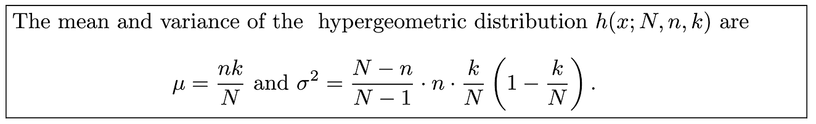
Theorem 5.2
Copyright © 2017 Pearson Education, Ltd. All rights reserved.
5 - <number>

Slide 7
Section 5.4
Negative Binomial and Geometric Distributions

Slide 8
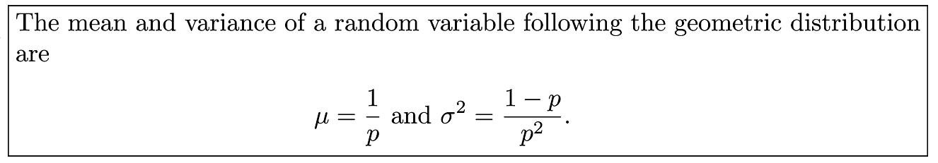
Theorem 5.3
Copyright © 2017 Pearson Education, Ltd. All rights reserved.
5 - <number>

Slide 9
Section 5.5
Poisson Distribution and the Poisson Process

Slide 10
Theorem 5.4
Copyright © 2017 Pearson Education, Ltd. All rights reserved.
5 - <number>

Slide 11
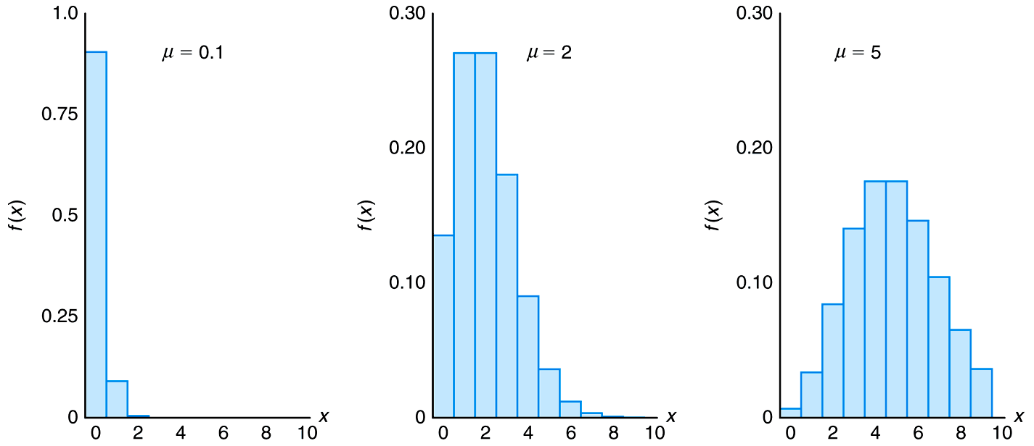
Figure 5.1 Poisson density functions for different means
Copyright © 2017 Pearson Education, Ltd. All rights reserved.
5 - <number>

Slide 12
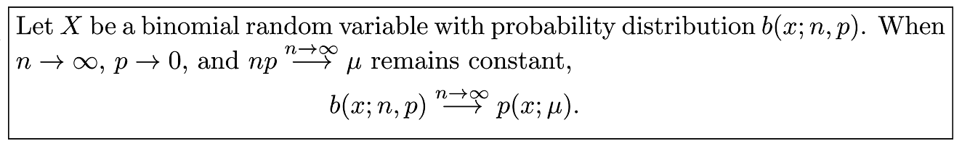
Theorem 5.5
Copyright © 2017 Pearson Education, Ltd. All rights reserved.
5 - <number>

Slide 13
Section 5.5
Potential Misconceptions and Hazards; Relationship to Material in Other Chapters

